Slide 1
SOLAR POWER GENERATION

Slide 2
Project by
Vedant Pawar
Mohammed Shaikh
Tasmiya Fatima
Ratan Guddeti
Akshay Menon
Saumith Ail
Uday Kharchane

Slide 3
Introduction
Overview:
This project focuses on leveraging machine learning techniques to predict solar power generation using historical and environmental data.
Scope:
The presentation will cover three main areas: Exploratory Data Analysis (EDA), model building, and deployment. Each section will delve into the methodologies, tools, and best practices involved.
Business Objective
The variable to be predicted is continuous (energy production). Therefore, this is an Regression project. The primary goal is to model energy production as a function of environmental variables.

Slide 4
Exploratory Data Analysis (EDA)
Exploratory Data Analysis (EDA) is a critical step in the data analysis process. It involves analyzing the main characteristics of the data set, often visualizing the data, to understand its structure, discover patterns, spot anomalies, and check assumptions before applying more advanced statistical methods or machine learning algorithms.
EDA helps in:
Summarizing the dataset: By using descriptive statistics to get insights into the data, such as mean, median, mode, variance, and standard deviation.
Visualizing the data: Employing plots like histograms, bar charts, box plots, scatter plots, and heatmaps to get a better understanding of the distribution and relationships in the data.
Identifying outliers and anomalies: Detecting unusual data points that might indicate data entry errors or significant insights.
Handling missing values: Understanding the nature and extent of missing data to decide on appropriate methods for dealing with them, such as imputation or removal.

Slide 5
Techniques
Handling Missing Values: Identifying and addressing missing data through techniques such as imputation, deletion, or using algorithms that can handle missing values.
Outlier Detection: Identifying unusual data points that can skew the analysis. Techniques include using, IQR methods, and visual inspections via box plots.
Feature Selection: selecting the most important features using hypothesis testing and using ols method and using random forest regressor it gives the importance score of features.
Data Scaling : using the standard scaler we scaled the data that is beneficial for our model to learn patterns amongs the data.

Slide 6
Tools & libraries
Data manipulation:
Pandas
Numpy
Data visualization
Matplotlib
Seaborn
Data Preprocessing
Standard scaler
Train Test split
Model Building:
Scikit-learn
Model Evaluation
Scikit-learn
Model Deployment
Pickle
Streamlit
css
IDE:
Jupyter Notebook
Visual Studio Code

Slide 7
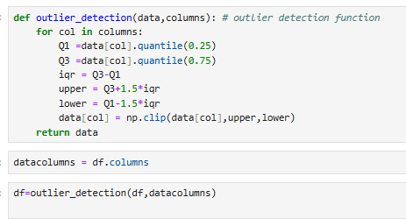
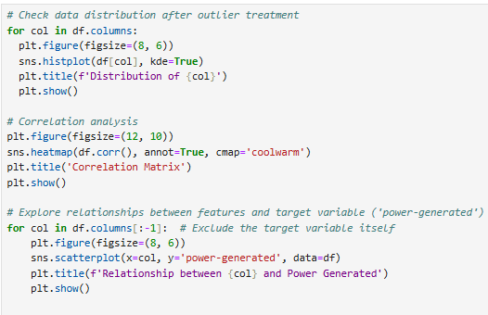
EDA Code:
Outlier Treatment
Histogram

Slide 8
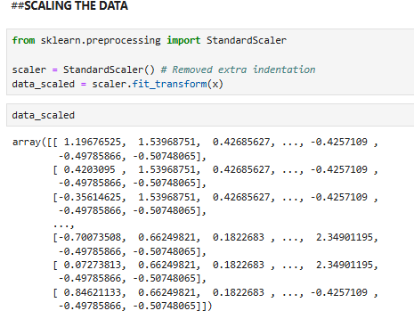
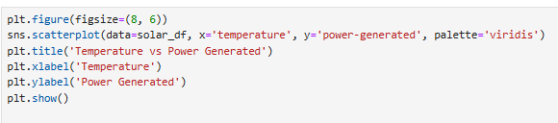

Visualisation
Temperature vs power generated scatterplot
Correlation Matrix
Scaling the data

Slide 9
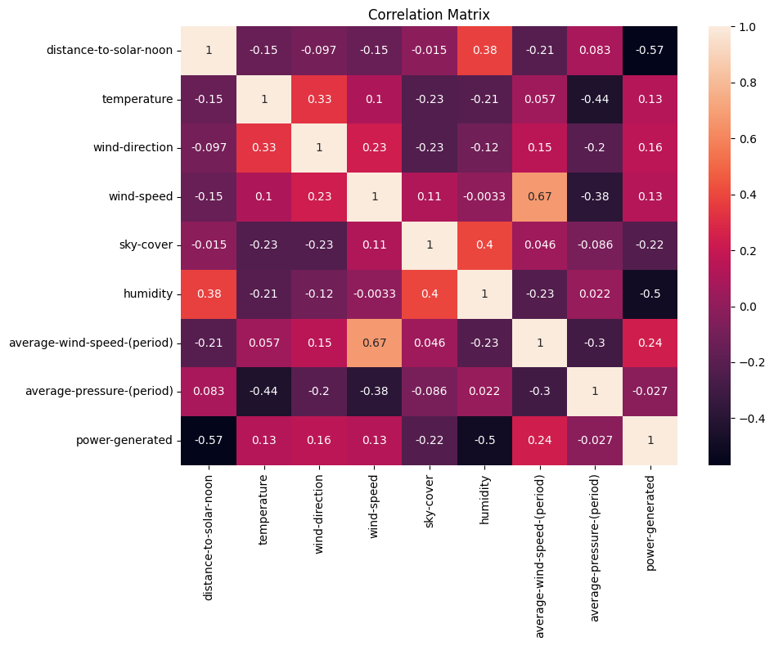
Correlation-Matrix
Insights:
The target variable, power-generated, has a strong negative correlation with distance-to-solar-noon (-0.75). This means the closer it is to solar noon, the higher the power generation.
Humidity also has a moderately negative correlation with power generation (-0.54). Higher humidity reduces power generation
Variables like temperature, wind-direction, wind-speed, and average-wind-speed-(period) show weak positive correlations (close to 0.1–0.27) with power generation, suggesting they have minimal influence individually.
Sky-cover and average-pressure-(period) have very weak or negligible correlations (-0.19 and -0.037, respectively), implying they likely don’t affect power generation much.

Slide 10
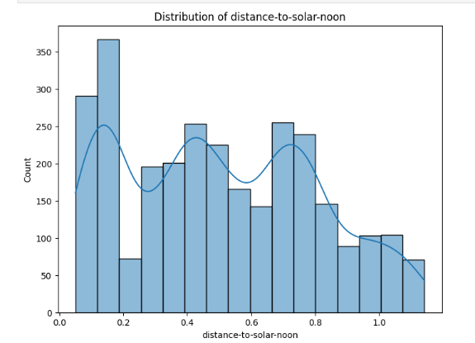
histograms
Insights:
The data is balanced with multiple ups and downs, indicating a multi-modal pattern.
The values range evenly between 0 and 1, suggesting a normalized scale.
The smooth curve (kernel density) highlights the general trends in the data.
The periodic peaks may represent specific patterns or timings in solar noon distances.

Slide 11
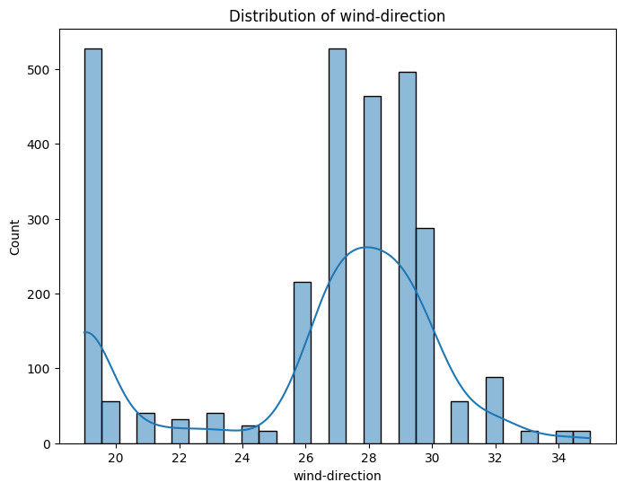
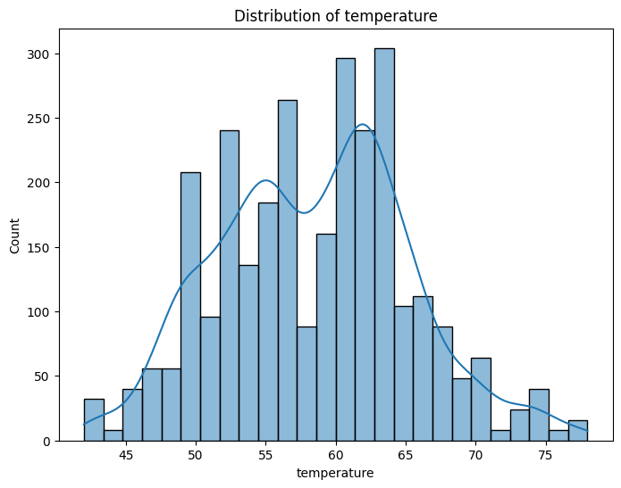
Insights:
The wind direction distribution is multimodal with peaks around 20, 27, and 30 degrees, suggesting varying wind patterns and potential shifts in wind direction Wind direction is slightly skewed.
Insights:
The temperature distribution is unimodal and slightly right-skewed, indicating a concentration of values around the peak (around 60-65 degrees) with a longer tail towards higher temperatures.

Slide 12
Model Building
Data Preprocessing:
Cleaning:
Removing duplicates, fixing data entry errors, and standardizing formats.
Normalization:
Scaling features to ensure they contribute equally to the model, usually done via techniques like min-max scaling or z-score normalization.
Feature Engineering:
Creating new features from existing data to improve model performance. Examples include extracting keywords from resumes or creating binary indicators for specific skills.

Slide 13
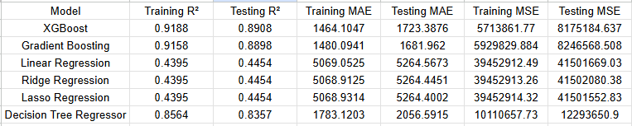
Model Evaluation Table:

Slide 14
Model Evaluation metrics
Mean Squared Error (MSE): Measures the average squared difference between predicted and actual values. Lower is better.
Root Mean Squared Error (RMSE): Square root of MSE, providing error in the same units as the target variable. Lower is better.
Mean Absolute Error (MAE): Measures the average absolute difference between predicted and actual values. Lower is better.
R-squared (R²): Represents the proportion of variance in the dependent variable explained by the independent variables. Higher is better.

Slide 15
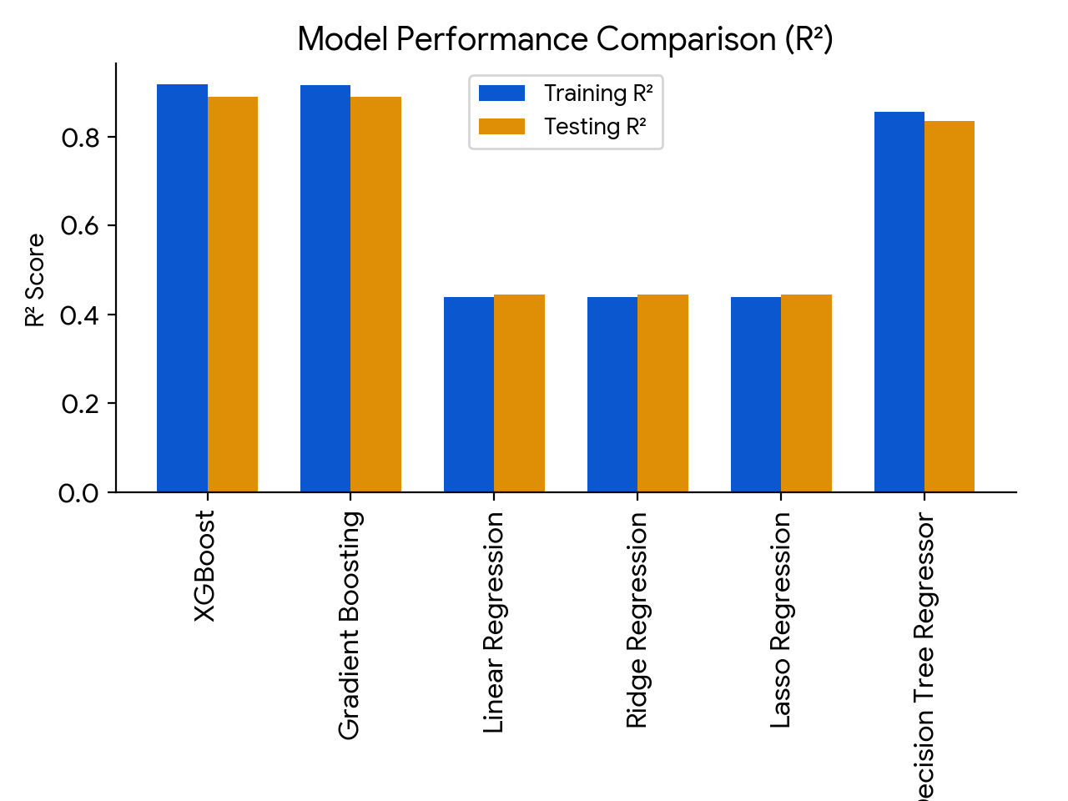
Model Evaluation

Slide 16
Model Deployment Using Stream-lit
Stream-lit is a powerful Python library that allows you to build and share data apps with minimal coding effort. It's perfect for quickly prototyping and deploying machine learning models.
Why we use Stream-lit:
Simplicity: Create interactive web apps with just Python code.
Speed: Rapid development and deployment.
Flexibility: Customize your app's appearance and functionality.
Sharing: Easily share your app with others.

Slide 17
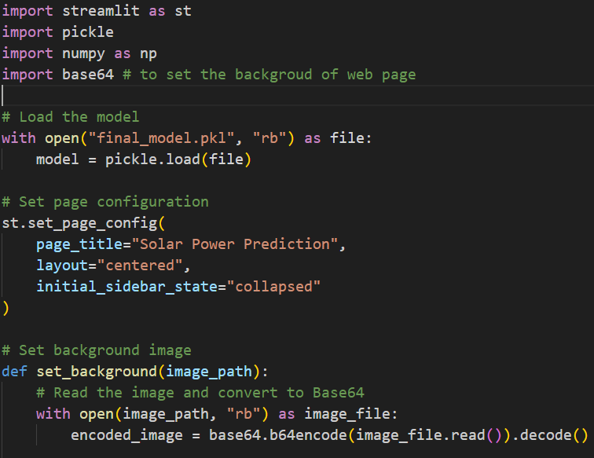
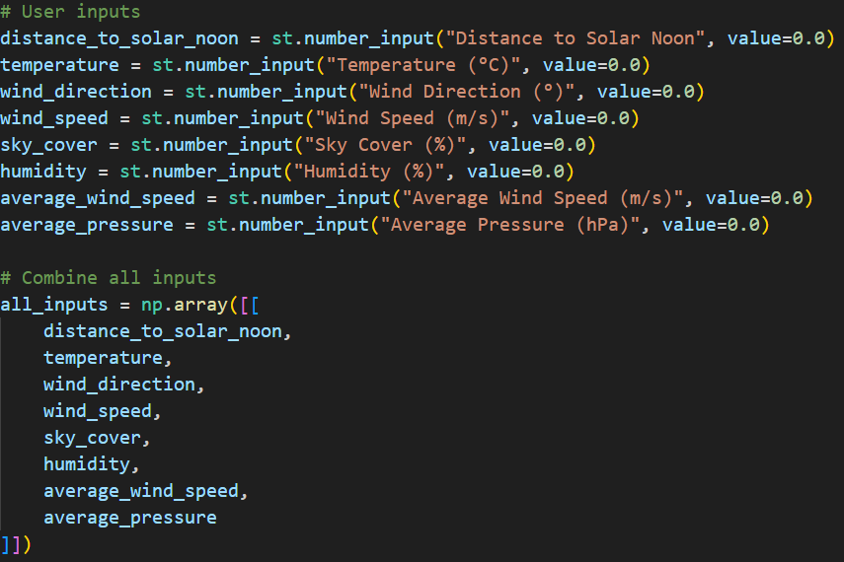
Stream-lit code

Slide 18
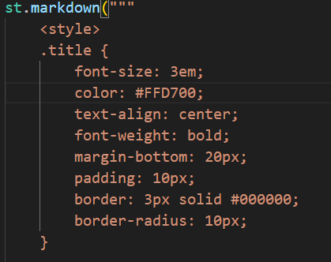
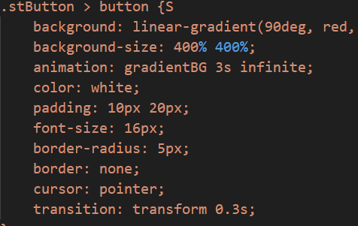
CSS code for page design and layout:

Slide 19
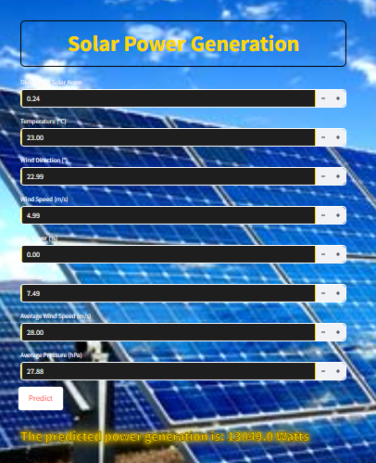
Output:

Slide 20
Challenges & Learnings
Challenges:
Selecting the important features and best model.
Setting up Streamlit for deployment.
Learnings:
Importance of hyperparameter tuning for improved accuracy.
Effective feature engineering techniques.
Making the model pipeline save the lot of time for same process.

Slide 21
Thank you!

